Slide 1


Slide 2
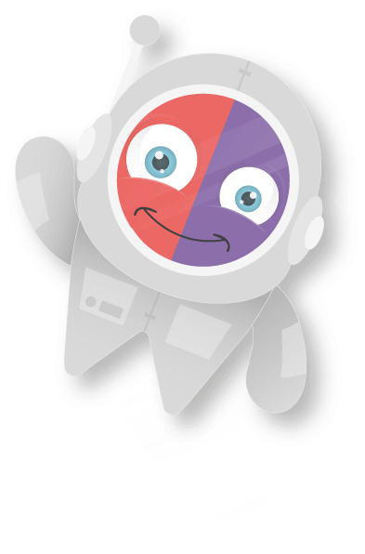

Meet Emile
Emile is a young shape shifting alien trying to save the Universe from Scrambler.
Explore his universe, where you will gather new knowledge from different planets and stop Scrambler from stealing all the Knowledge Gems!

Slide 3

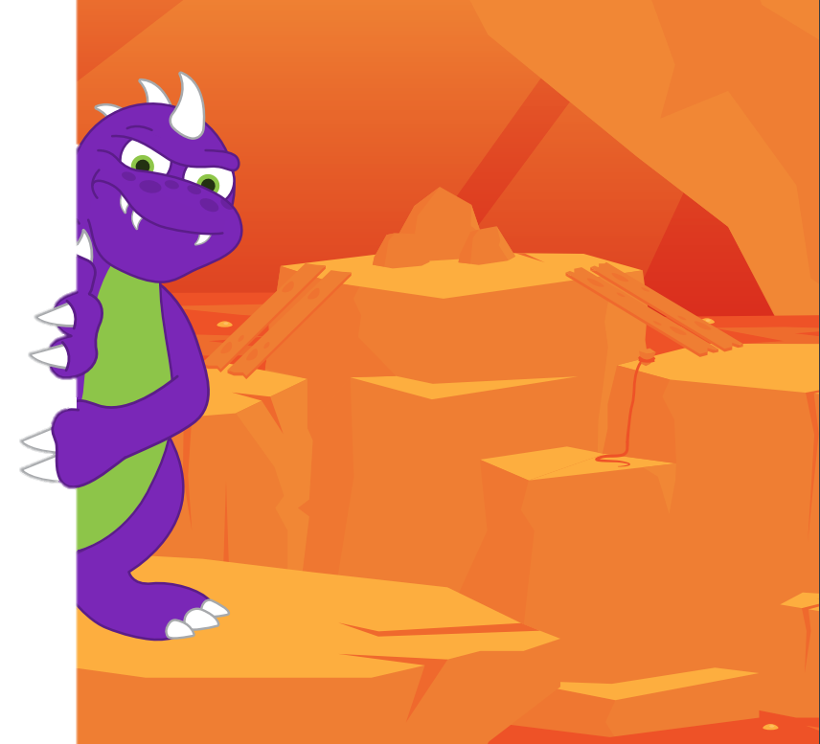
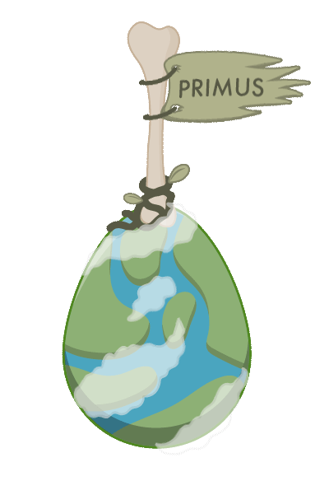
Introducing
Scrambler...
There was a dinosaur-like creature called “Scrambler” who lived on the planet Primus.
Unlike many other planets in the universe, Primus was a prehistoric world filled with lots of dinosaurs and ancient unevolved creatures.

Slide 4
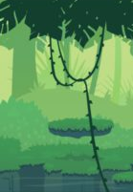

Scrambler.
Scrambler was a simple dinosaur.
He lived alone and was not interested in learning.
One day, when Scrambler was out looking for some food, he tripped over something buried in the ground. He quickly dug it up and took a closer look. It was a shiny gem!

Slide 5

Scrambler.
Being a simple dinosaur, Scrambler had no idea what a powerful object he had discovered.
He dusted the dirt off, and the gem began to glow. Before Scrambler knew it, he had received his first taste of intelligence from a knowledge gem.

Slide 6

Knowledge Gems
After getting a taste of learning, Scrambler became obsessed with tracking down as many knowledge gems as he could. He wanted to hoard them for himself without sharing his knowledge with others.
As Scrambler continued his quest, he guessed that other planets must also have knowledge gems.

Slide 7

Knowledge Gems
As Scrambler became more knowledgeable, he was able to build a spaceship and continue his quest to collect the gems from other planets throughout the Universe.
However, by taking gems from other planets he was robbing these civilisations of their knowledge. But Scrambler didn’t care as he had no empathy for others.

Slide 8

The Heist
Scrambler’s quest brought him to Emile’s planet of Mathedonia.
Scrambler executed a simple heist as had done countless times before netting another huge haul of knowledge gems.

Slide 9

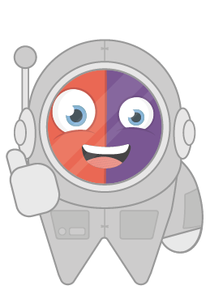
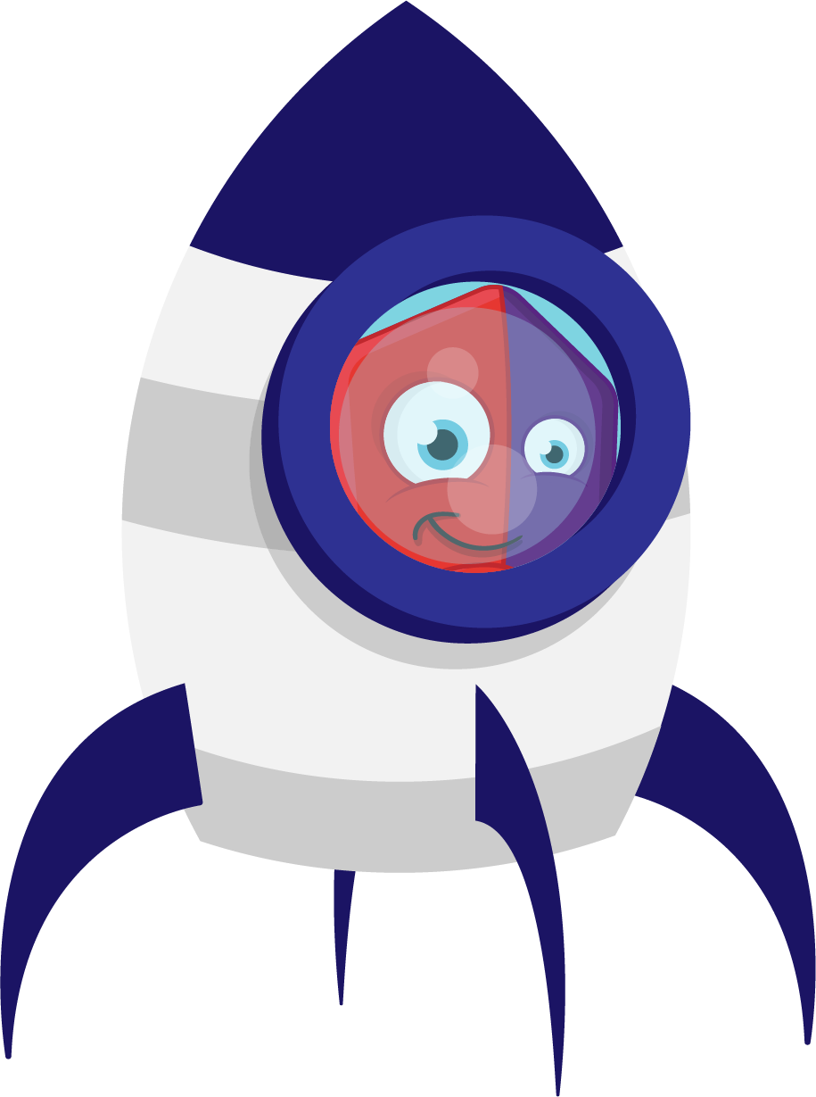
The Heist
However, a young shape shifting alien called Emile spotted the heist. With the help of his best friend Aimee (the Artificial Intelligence Maths EnginE), they had the courage to chase after Scrambler.
It was from then on Emile and Aimee decided it was their duty to help protect other planets throughout the galaxy from Scrambler and his quest for stealing knowledge.

Slide 10
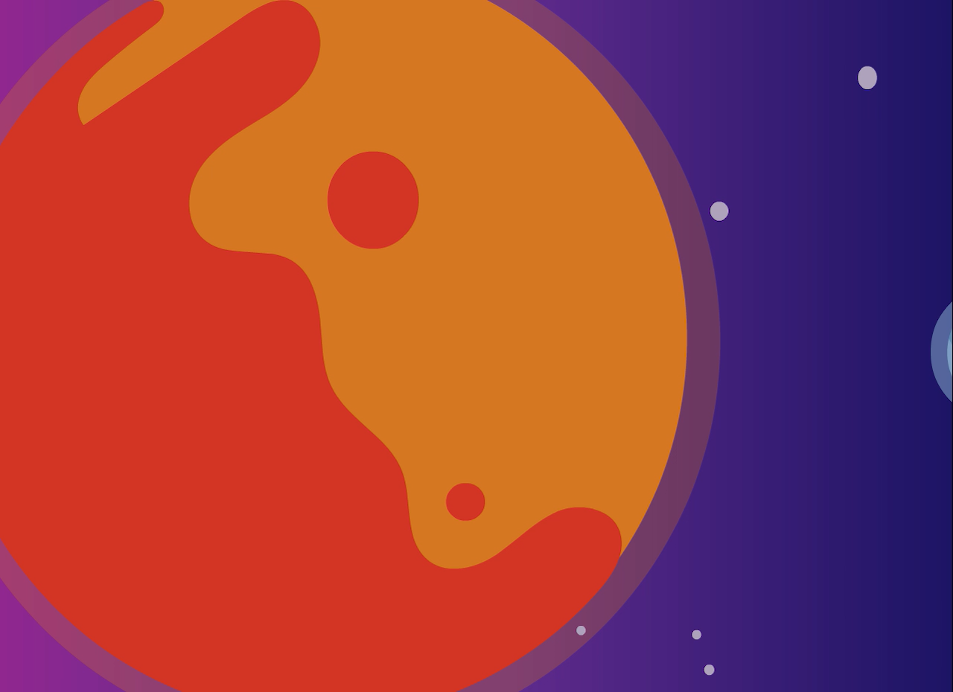
The Heist

Slide 11
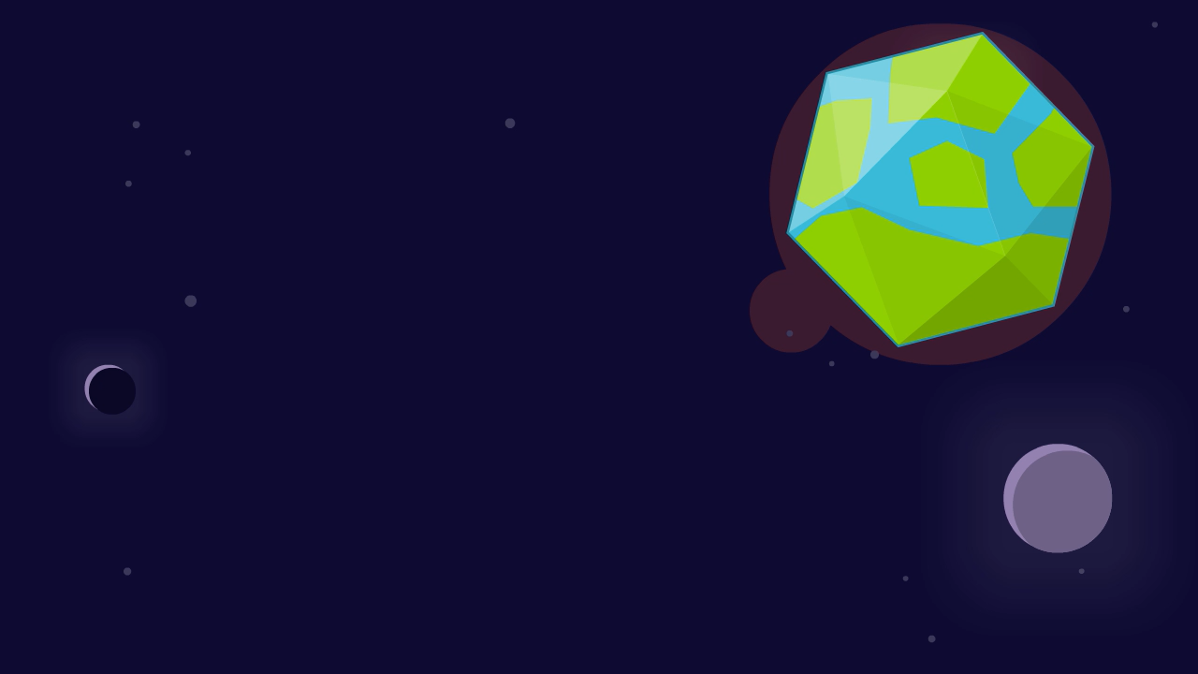
Emile & Aimee
Emile and Aimee now travel throughout the universe sharing their knowledge to help solve problems on the planets they visit and most importantly stop Scrambler from stealing all the knowledge in the Universe.

