Slide 1


The Multiplication Tables Check
(MTC)

Slide 2
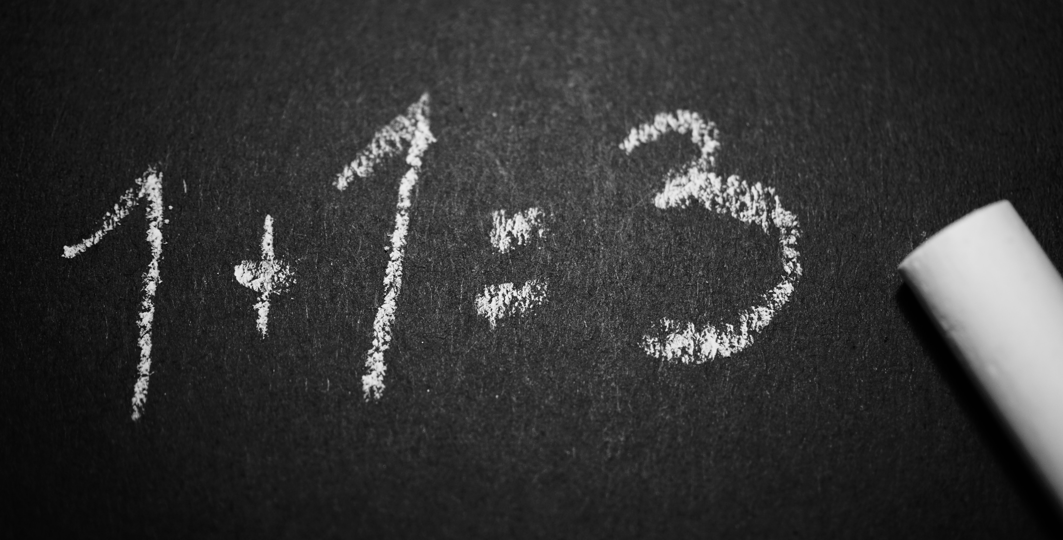


What is The MTC?
It’s a new national test for Year 4 students
We’re not worried
Under the national curriculum primary school children are expected to know their 12 times tables by the end of Year 4
So we’ve been preparing students to know their times tables by the end of Year 4 for quite some time now and are not concerned about the check at all

Slide 3

The practicalities
The Check Itself.
Takes place in June
Is done on a tablet or computer
Will take no longer than 5 minutes
There are 25 questions
Pupils have 6 seconds to answer each question
There’s no problem solving or division just simple “3 x 4 = ?” type questions
The results are for Teachers
There is no pass or fail mark
Results are not published

Slide 4
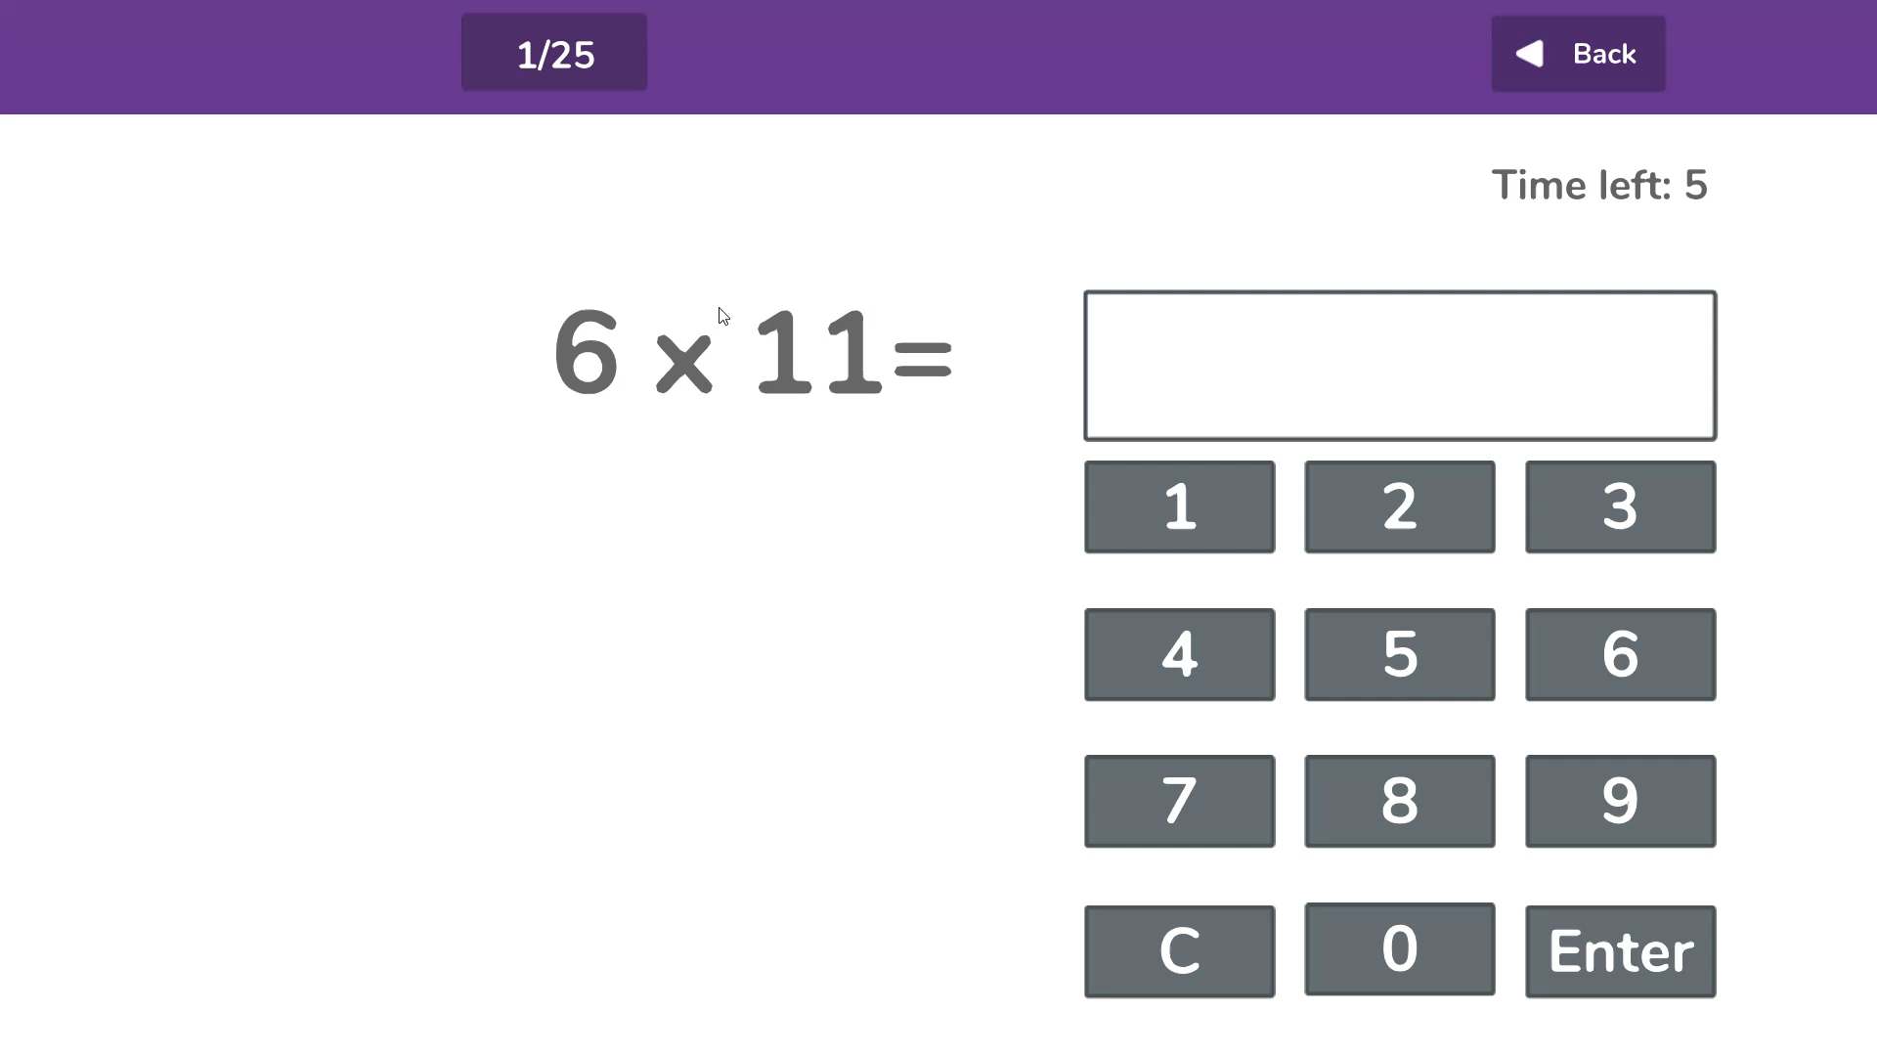

Slide 5

No Stress
Government has called it a “check” rather than a “test” or “exam” for a reason.
We will endeavour not to draw students’ attention to the check so will be not be referencing in class unduly.
Please be supportive of this approach and refrain from talking about the checks at home.

Slide 6


How You Can Help YouR Child?
Practise at Home
We will of course continue to teach the full curriculum, and would love your continued support to help practise the times tables with your children.
Some easy ways to do this include:
asking questions such as “What’s 7 x 8?”
reciting times tables by Rote (4 times 1 is 4, 4 times 2 is 8, etc)
singing times tables songs (there are loads online)
using apps and games (like Emile)

Slide 7
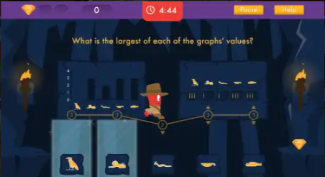
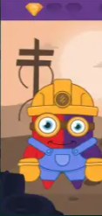
Emile
We have signed up for FREE access to an app that mimics the check, called “Learn with Emile”
Your child’s username and password will be sent out
This app features not only the check but a number of games and activities that will help your child learn and understand times tables
The app can be downloaded from the Apple Store, Google Play Store, Kindle/Amazon Store or Microsoft Store for FREE and is called “Learn with Emile”

Slide 8

Thank
You
for your continued support

