Slide 1
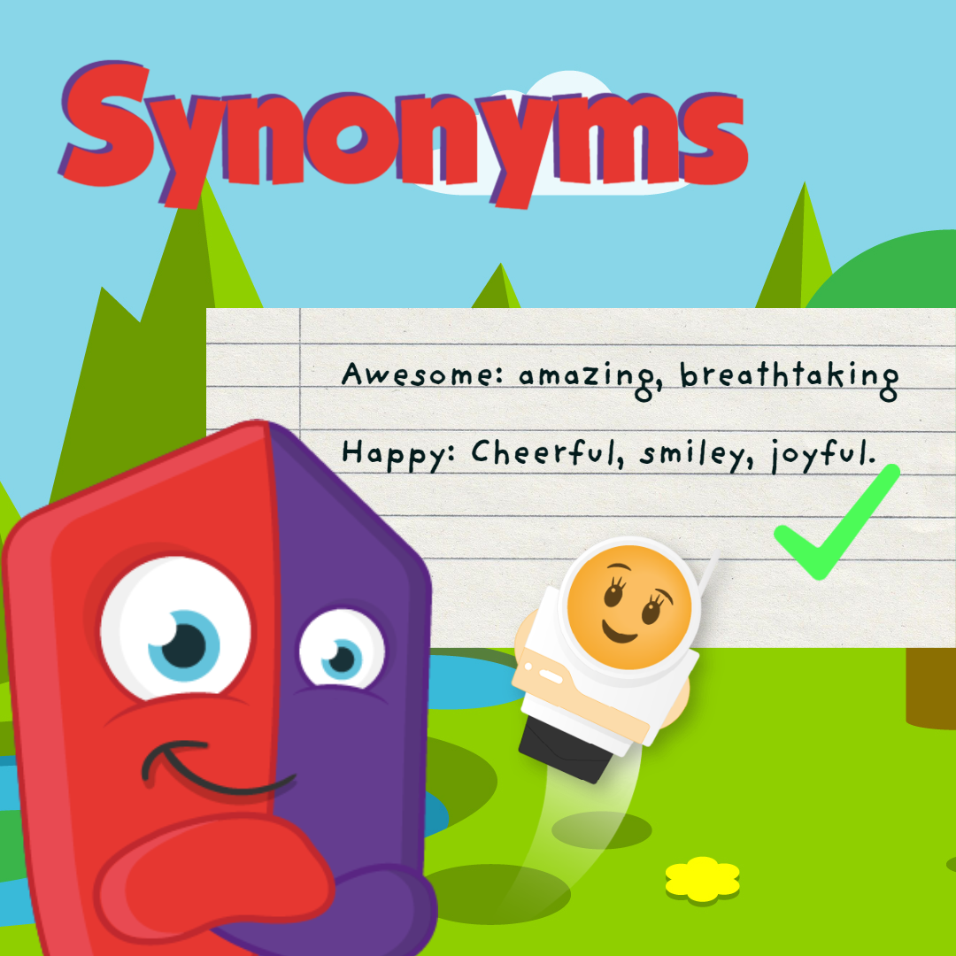

Slide 2
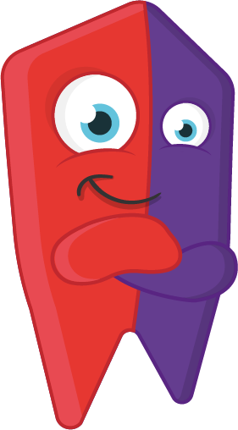
What is a Synonym?
A synonym is a word with similar meaning to other.
For example:
Small > Tiny and miniature.
But why do we use synonyms?
To expand our vocabulary
To be more creative
To create more interesting sentences.

Slide 3
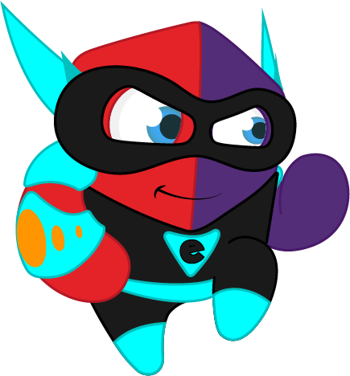
The Encouragement Game
This game consists on you making use of your thesaurus and your language skills.
A word will be shown on the board - in groups come up with as many synonyms as you can.

Slide 4
GOOD

Slide 5
BAD

Slide 6
SAD

Slide 7
HAPPY

Slide 8
AWESOME

Slide 9
NASTY

Slide 10
QUIET

Slide 11
LOUD

Slide 12
HOT

Slide 13
COLD

