Slide 1
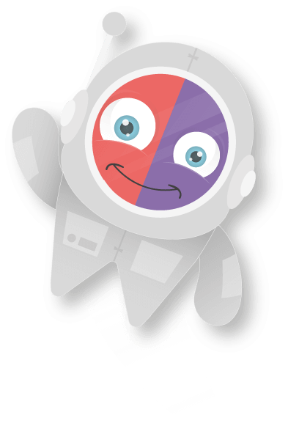
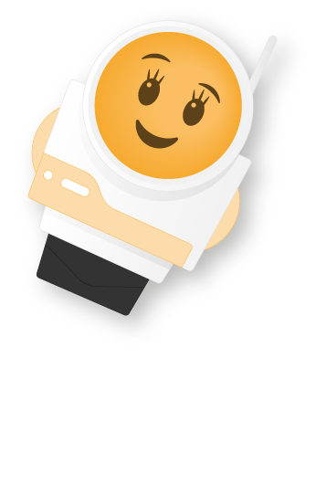
Antonym’s
A small guide with Emile!

Slide 2
Learning objectives
To know what an antonym is
To be able to identify antonyms
To be able to use antonyms to improve our vocabulary and writing.

Slide 3
What is an Antonym?
Antonyms are words with opposite meanings. Believe it or not but they are what make our vocabulary so rich and meaningful. Imagine if we used basic and simple words to express ourselves? It would be so boring!
Lost | Won
Happy | Sad
Funny | Serious
Clean | Dirty

Slide 4

Why do we use antonym?
Have a guess, why do you think we use opposite words?

Slide 5
Why do we use antonym?
Truth is, we use antonyms to expand our vocabulary. Therefore, instead of using simpler opposites, we use new and more interesting words.
Not just this, but it helps with learning new words! Which will help you sharpen your overall sese of the English language.

Slide 6
Do you understand what an antonym is?
From the list of words below, guess the antonym!
Love
Old
Lazy
Fake
Night
Healthy
Tiny
Soft

Slide 7
Using antonyms in sentences
Use the key provided to complete the sentences.
I could tell Adam was being………… when he told me he was moving away.
Anna and Siobhan are ……….. about the new Marvel film.
Jordan gets up in the morning to ……… the farm animals.
Yusef and Dylan have been best friends for … …… long time.
Amara has …… just met Pam, but they are already very close.
Key:
Ecstatic
Serious
A very
Only
Tend

Slide 8
Which word from the list below is an antonym for “sweet”
Tangy
Dirty
Sour

Slide 9
Which word from the list below is an antonym for “sweet”
Tangy
Dirty
Sour

Slide 10
Which word from the list below is an antonym for funny:
Noisy
Serious
Furious

Slide 11
Which word from the list below is an antonym for funny:
Noisy
Serious
Furious

